Slide 1
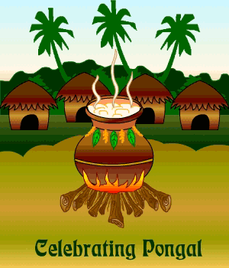
Festivals
of India
Pongalo
Pongal

Slide 2
Pongal is a harvest festival.
An occasion for traditional thanksgiving the nature.
Falls on the first day of the Tamil month of ‘Thai’ (14th Jan or 15Th Jan on a leap year).
It is a four day festival – Bhogi, Thai Pongal, Maattu Pongal and Kaanum Pongal.

Slide 3
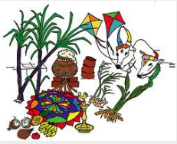
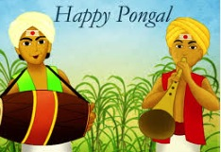
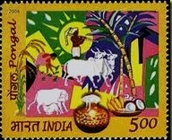
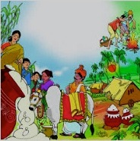
and
Makara Sankranti

Slide 4
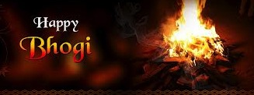
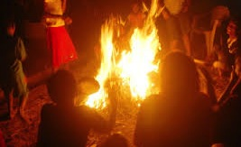
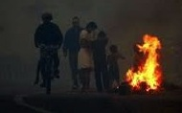
Day 1
The Bonfire
People assemble at dawn to light a bonfire, and discard old unwanted household possessions. Homes are cleaned, painted and decorated to give a festive look.

Slide 5
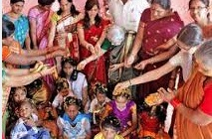
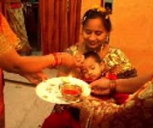
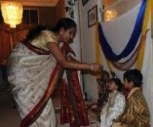
Bhogi Pallu
The fruits from the harvest are collected, along with flowers of the season, in a ceremony called Bhogi Pallu. Money is often placed in the mixture of Bhogi Pallu, and the mixture is poured over children, who then collect the money and sweet fruits.

Slide 6
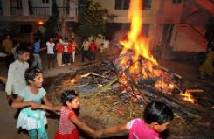
Children dance around the bonfire, singing songs in praise of the Gods, the spring and the harvest. Girls also apply henna /mehandi

Slide 7
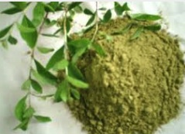
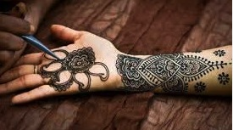
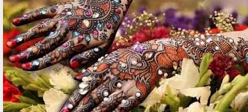
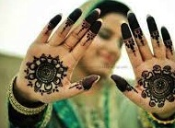
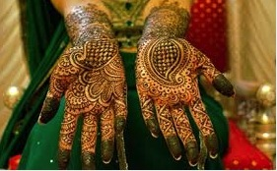
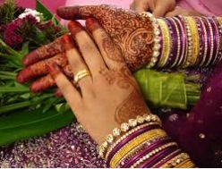
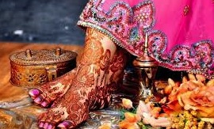
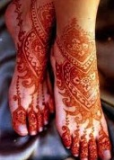
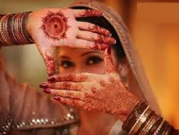
H
E
N
N
A

Slide 8
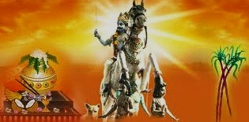
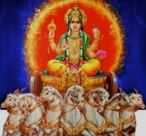
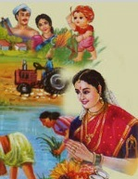
Lord Indra (the God of clouds and rain) is worshipped for the abundance of harvest. A special puja is performed before cutting the paddy. Farmers worship the Sun and the Earth by anointing their ploughs and sickles with sandalwood paste. It is with these consecrated tools that the newly-harvested rice is cut. Fresh harvest of rice, turmeric and sugarcane are brought in from the fields, as preparation for the following day.

Slide 9
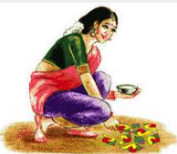
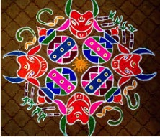
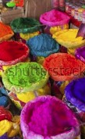
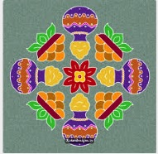
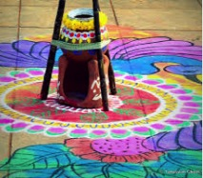
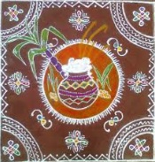
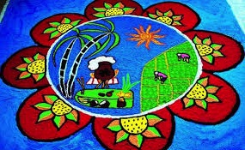
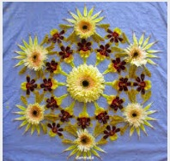
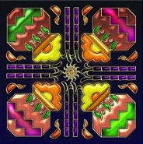
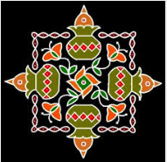
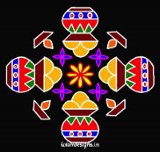
Kolams (rangoli patterns) are drawn with the white paste of newly harvested rice and outlined with red mud.

Slide 10
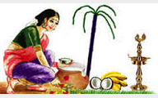
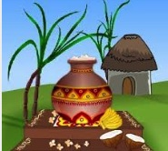
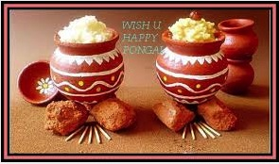
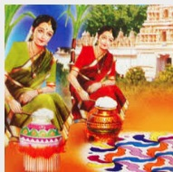
Day 2
Thai Pongal
It is celebrated by boiling rice in new clay pots. The rice is later topped with sugar, ghee, cashew nuts and raisins. This tradition gives Pongal its name. The rice is traditionally cooked at sun rise. The moment the milk boils over and bubbles out of the vessel, the tradition is to shout of "Pongalo Pongal!", introduce freshly harvested rice grains in the pot and blow the sanggu (a conch). Tamilians consider it a good sign to watch the milk boil over as it connotes good luck and prosperity. The newly cooked rice is traditionally offered to the Sun God at sunrise to demonstrate gratitude for the harvest. It is later served to the people present in the house for the ceremony. People prepare savories and sweets, visit each other and exchange greetings.

Slide 11
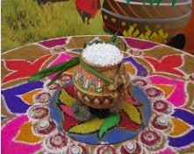
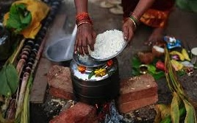
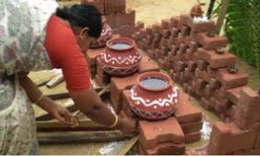
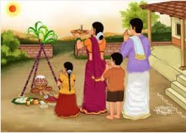
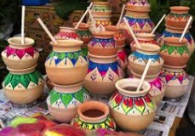
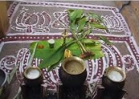
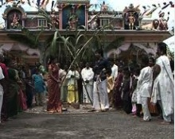
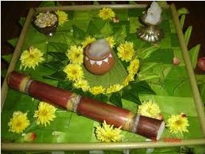
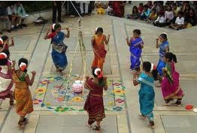

Slide 12
People wear traditional clothes…..

Slide 13
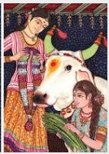
Maattu
Pongal
Day 3
Cattle play an important role in the traditional Indian farmstead be it with regards to the provision of dairy products, its use for ploughing and transport and its provision of fertilizer. This explains the Tamilians reference to cattle as wealth. Maatu pongal is a festival celebrated together by the villagers to thank the cows for their favour in farming. People bathe their cattle and paint their horns with colourful paints. In the evening people offer prayers to Lord Ganesh made out of mud and all the cattle of the village are gathered together and are decorated with garland and turmeric water. Kumkum is applied on the forehead and fed with a mixture of venn pongal, Jaggery, honey, fruits etc. One of the rituals is to make a torch using coconut leaves, light it with fire, go around cattle thrice holding it and then run to the border of the village to drop it there. It is believed that this removes the evil influences caused by the jealousy of other people over the cattle. Women offer prayers in the hope that the brother-sister ties may remain forever strong.

Slide 14
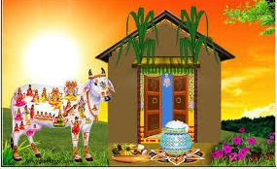

Slide 15
J
A
L
L
I
K
A
T
T
U
On the day after Pongal, cattle are felicitated. In rural Tamil Nadu, adventurous games such as the Jallikkattu or taming the wild bull are features of the day.

Slide 16
Day 4
This is a time for family reunions in Tamil Nadu. Falling on the third day of the Pongal festivities, brothers pay special tribute to their married sisters by giving gifts as affirmation of their filial love. Women offer prayers in the hope that the brother-sister ties may remain forever strong. Landlords present gifts of food, clothes and money to their workforce. During Kaanum Pongal (the word kaanum in this context means "to visit"), people visit relatives and friends to enjoy the festive season. In the cities this day is synonymous with people flocking to beaches and theme parks to have a day out with their families. They also chew sugar cane and decorate their houses with kolam . This day is a day to thank relatives and friends for their support in the harvest. Although it started as a farmers festival, today it has become a national festival for all Tamilians irrespective of their origins or even religion. It is as popular in urban areas as is in rural areas. This festival also marks the end of the Pongal festivities for the year

Slide 18
Celebrated on Jan 14th as a festival of Makar Sankranti. The entire sky becomes a showcase of colorful kites of various sizes and shapes. People visit friends and relatives to exchange homemade delicacies.

Slide 21
Thanks for watching

